Slide 1
Place and route
Get an overview of place and route steps
Place and route follows the synthesis, which is explained in
http://ipe-iperic-srv1.ipe.kit.edu/doc/dds/ss18/lab/assignment2/Assignment2.html
and in the slides DDS19_6_Synthesis.pptx

Slide 2
Design flow
Technology files (liberty, qrc techfile, abstract)
Functional netlist (.v, .vhd, .sv)
Timing constraints (sdc)
Synthesis (Genus)
Design import
Floor plan
Power planning
Netlist (.v)
Special placing
Placing
Place and Route (Innovus)
Clock tree synthesis
Routing
Layout in OA or gds
Netlist in Verilog
Sdf file for post extraction simulations
Sign off

Slide 3
Analog on top
Quite often chips contain analog and digital circuits. In this case, we are talking about a mixed mode chip.
There are two ways how a mixed mode chip can be designed. The first possibility is “analog on top”. The digital parts are automatically synthesized and layout is generated by the tools “Genus” and “Innovus”.
Virtuoso
full custom design, final chip integration, LVS, DRC)
Genus
(synthesis)
.v
Innovus
(P&R)
.v .gds
.gds

Slide 4
Digital on top
In the case of “digital on top” design flow, analog blocks, which are designed in Virtuoso, are imported into Innovus and placed automatically. This design flow avoids manual routing of lines between analog and digital blocks. It checkes timing automatically. Analog blocks are taken by Innovus as an abstract view. Sdc file for the top module is needed. Lib file of the analog block could be provided as well.
Genus
(synthesis)
.v
Innovus
(P&R, final chip integration, LVS, DRC)
.gds
.lef .lib
Virtuoso
(full custom design)

Slide 5
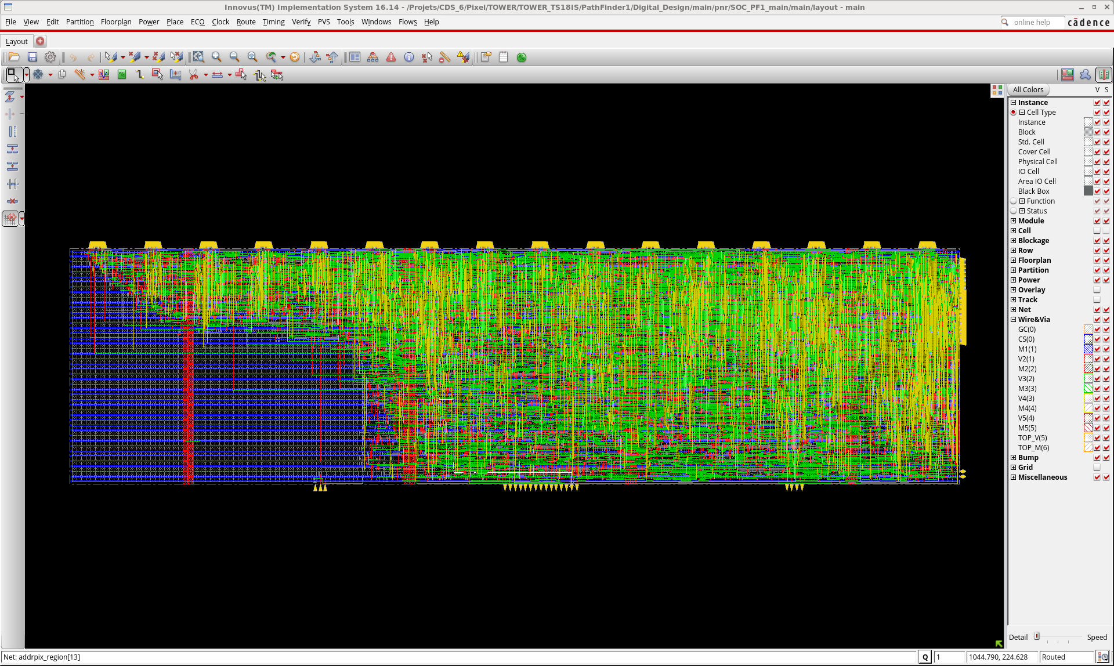
GUI (manual input of commands) vs. script
P&R tool Innovus has graphical user interface (GUI) and allows performing of steps by mouse click and form filling. GUI can be used for learning, but it is impractical when whole P&R has to be repeated many times.
The first set in P&R is importing of design. The netlist should be imported, top cell name specified, power and ground nets defined. Process node should be specified to tune the extraction of capacitances and resistances of metal lines.
5

Slide 6
Floor planning
The floor planning include following tasks: defining of design dimensions and area for input-output- (IO-) cells, pin placement, placing of reusable pieces of logic (hard-macros or intellectual property (IP) cells)
The output of the floorplan is the design exchange format “def” file. This file gives information about macros in design, placement, pin location, metal blockages, orientation. The def file can be also used as input for Genus tool, to perform a new iteration of synthesis. In this way, Syntesis will have idea about design size and optimize the netlist accordingly

Slide 7
Floor planning
Choosing of correct size for floorplan is important. Floorplan should be big enough so that that there is space for all needed logic cells
Too high utilization is also not good. It should be enough free space so that the clock buffers can be placed and that the tool has the freedom to move the cells and optimize timing.
On the other hand, the floorplan should not be too big, because it may be too “empty” and the lines will be unnecessarily long which increases their capacitances and make circuits slow

Slide 8



Floor planning
The maximum area for floorplan is also limited by production costs. Big chips are more expensive. Also, not entire chip area can be used by logic circuits. The input-output- (IO-) contacts (pads) take quite a lot of space.
We distinguish here between the IO-bound designs (number of IO-pads is limiting factor) where the pads take the most of chip-space, because there are many input signals, are the core-bound designs where the core logic takes the most of the space.
Core Area Bound
I/O Bound
I/O Bound

Slide 9
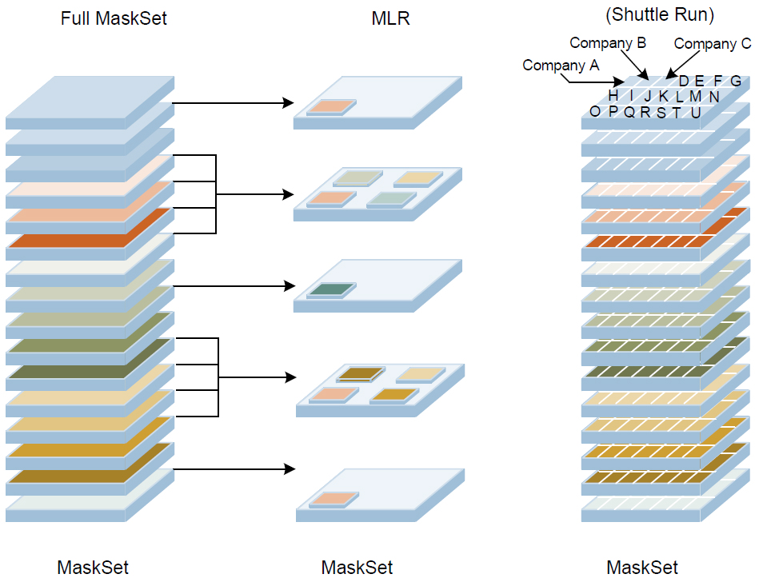
Three possibilities for chip production
To understand the production costs, let us introduce the three possibilities for chip production:
In the case of full mask set run, one customer uses the entire mask set for his design or designsThe size of the mask projection on the wafer, called the reticle, limits the maximum chip size
In the case of MPW shuttle run, many customers pay for a mask set and the reticle area is shared by many designs. The advantage is that the run cost is quite small for one customer.
In the case of MLM run, one mask is used for several layers. One customer pays for the mask set, and since less masks are needed than in the case of the full mask set run, the mask cost is reduced

Slide 10
Three possibilities for chip production
Full mask run
MLM
MPW shuttle run
Step 1
production of yellow layer
Step 2
production of red layer
Step 3
production of blue layer
Only this segment has correct structures

Slide 11
IO pads
IO-pads provide interface to external world. The IO-pad consists of the metal contact (the contact pad) and the IO-cell with electrostatic discharge (ESD) protection circuits and buffers. IO cells are in layout quite big. Like standard cells, they are designed to be abutted to each other.
PAD side (outside)
VDD
Standard height
VSS
Power rails
Core side (inside)

Slide 12
Analog pad
The slide shows the analog pad. The ESD protection is usually done with two diodes that conduct current when the pad voltage exceeds the level vddp (typically 1.8V) or drops below the level vssp (typically 0V).
IO-cell
circuit
pad
vddp
vssp

Slide 13
Analog pad
High current limits the voltage to ~ vddp + 0.6V
pad
circuit
vddp
vssp

Slide 14
Digital pad
This slide shows the digital pad. Its structure is more complicated. It contains ESD protection and a level shifter, whose purpose is to translate the logic levels from (vss to vdd) to (vssio to vddio)
circuit
Level shifter
pad
IO-cell
vddp
vssp
vddio
vssio
vdd
vss

Slide 15
Power domains
Power domains are used to separate various supplies. Typically we have analog and digital domains, but also multiple digital power domains are possible. Digital and analog domains are separated to avoid power supply cross talk. One digital domain can have a lower supply voltage to save power and another a higher voltage for better performances. Advanced options: Digital power domains can interface using level shifters placed by the tool. One digital power domain can be “shutdown” and put into a sleep mode.

Slide 16
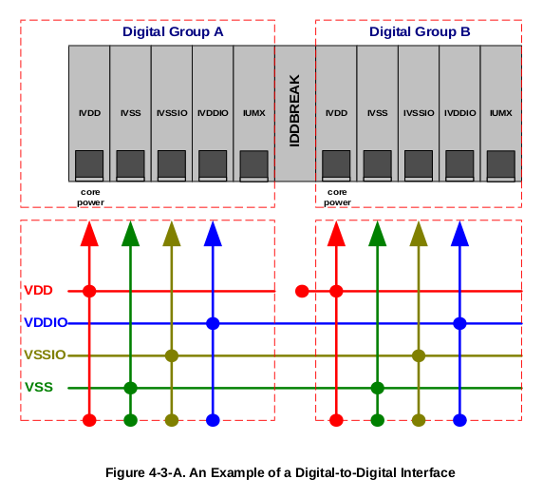
Power domains
IO cells have specific rules for power rail connections. When the cells are abutted the power rails will be shorted. In the case of IO cells that belong to different domains, spacing cells should be inserted to disconnect the rails.

Slide 17
Power domains
The slide shows as an example two digital pads that belong to two power domains with the core voltages vdd1 and vdd2. The vdd rail is cut.
circuit
Level shifter
pad
vdd1
Level shifter
pad
vss
vdd2
vddp
vssp
vddio
vssio

Slide 18
IO-cell and pad placement types
IO cells can be placed outside the core area. In this case, we are talking about the ring IOs.
IO cells can be also placed inside the core area, this type of cells are called area IOs.
Connection pads can be placed around the die, which is typical for pads for wire bonding.
Connection pads can be also distributed all over the chip area for flip-chip connection.

Slide 19
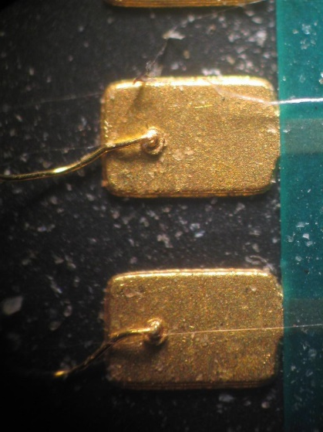

IO-cell and pad placement types
Example: Area IOs, connection pads for wire bonding
Die
core
IO cell
Connection pad
PCB
Package (ex: QSFP)

Slide 20
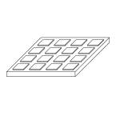
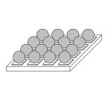
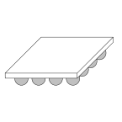
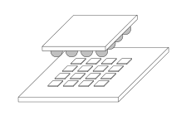
IO-cell and pad placement types
Example: Ring IOs, connection pads for bump bonding
Bump pad
die
package

Slide 21
IO-cell and pad placement types
Example: Complex wire bonding - Belle II detector prototype
Example: Bump bonding - Belle II detector final design

Slide 22
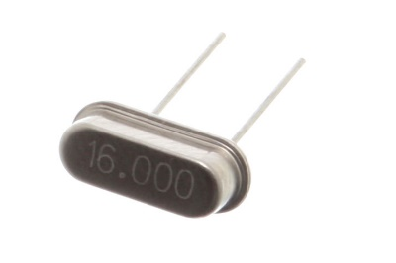

IO Cells can be of various types, depending on the technology library
Standard types:
  Power Connections: VDD,VSS,VDDIO,VSSIO
  Fillers: FILLER1, FILLER10, CORNER
  Signal Cell for Digital/Analog Signals
Special Cells:
  Differential Signal (LVDS), Oscillator cells etc…
power
clk
signal
fillers
Special Cells example: Oscillator

Slide 23
Partitions
Partitions are used to cut-off the design in smaller subset. Each subset is synthesized and implemented separately.
IO are planned
P1
P3
P3
P2
Final: “Injection”
Top level
Partition Level: Full Implementation
empty

Slide 24
Hard macros or IP blocks
Hard macros or IP blocks are design blocks similar to partitions, but provided by companies and ready to use. The hard macros are described by lef files that provide size and contact information. Most common hard macros are SRAMs and PLLs. They are placed like any other standard cell.
RAM
RAM
RAM
RAM
Sometimes design have many rams

Slide 25
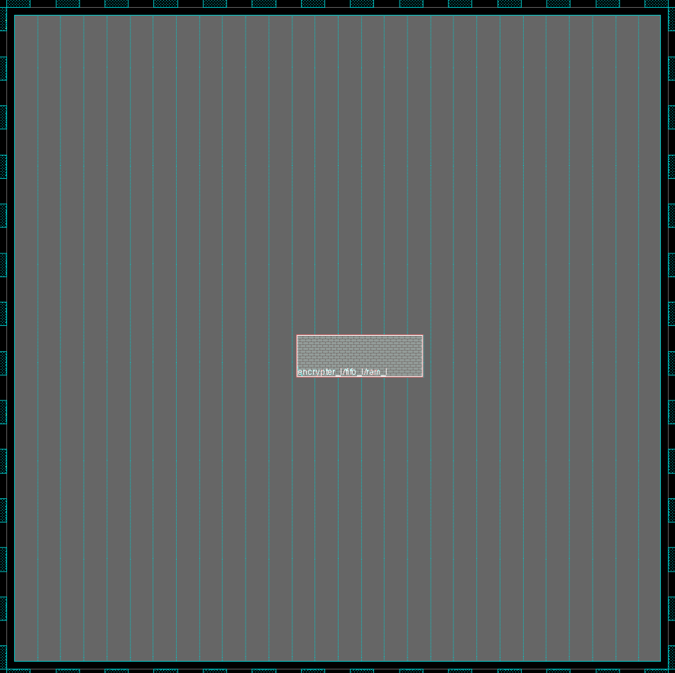
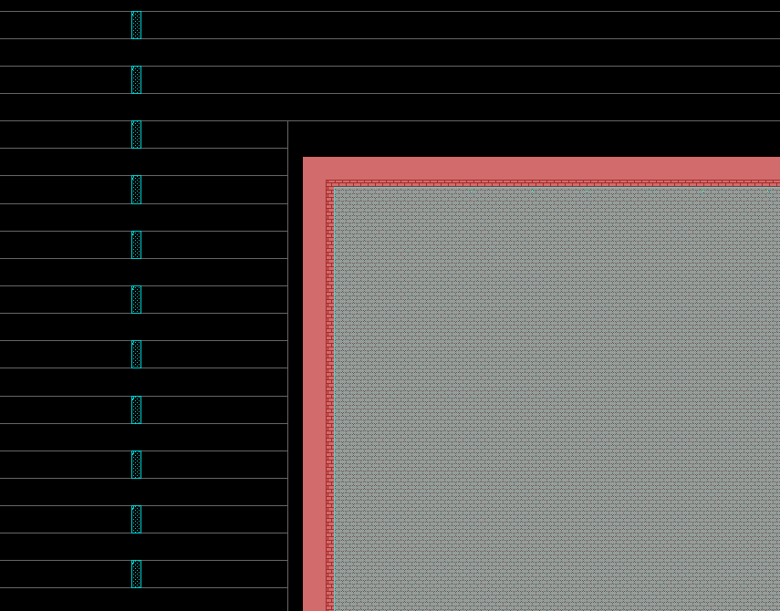
Hard macros or IP blocks
Well Tap Cells
No row

Slide 26
Well- and substrate contacts
Bulk contact is used to connect the p-type substrate (or p-well) with the negative supply voltage VSS or ground GND. Similarly, a PMOS transistor requires the n-well contact that is shorted with the positive supply voltage VDD.
Poly
Aktiver Bereich
Gate
SiO2
Bulk
Source
Drain
Feld-Oxid
P-dotiert Si
Substrat
N-dotiert Si

Slide 27
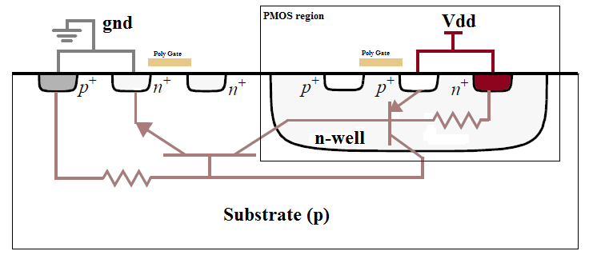
Well- and substrate contacts
If the p-well or n-well are not connected, their potentials can change and turn on parasitic bipolar transistors. This may lead to the “latch up”, an effect that causes a high current between VDD and VSS and may damage chip.
Well Tap
Well Tap
Rsub(n)
Rsub(p)
https://en.wikipedia.org/wiki/Latch-up

Slide 28
Well- and substrate contacts
The p-well and n-well contacts can be placed in each standard cell

Slide 29
Well- and substrate contacts
or they can be shared by several standard cells
Well tap cell

Slide 30
Well- and substrate contacts
The well tap cell must not be too far from a MOSFET, otherwise the latch up may occur. To assure this the distance between well tap cells must not exceed typically 50µm
Well tap cell

Slide 31
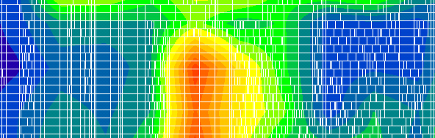
Power planning and Power Analysis
Power connections are important, if they are too thin the voltage drop across the circuit can be large. This can affect the performances. Functional power analysis can be done but the best solution is to make power connection as good as possible and in this way avoid problems.
IR Drop example

Slide 32
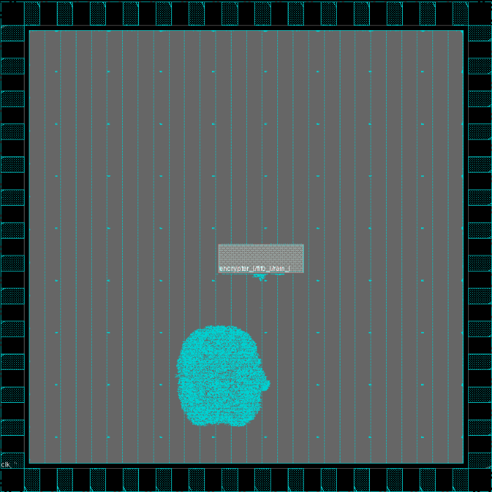
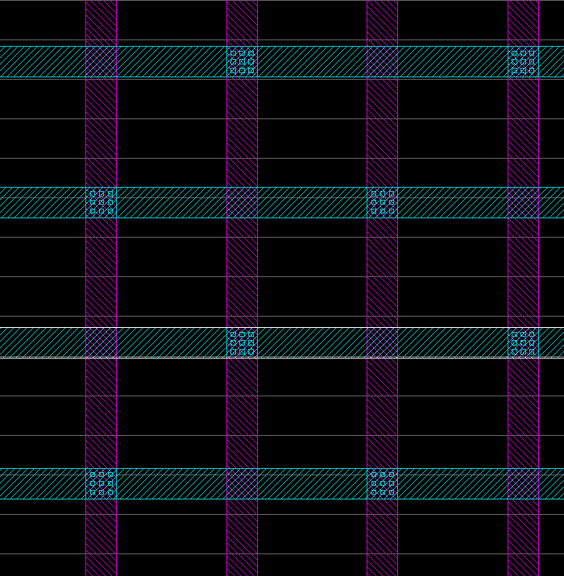
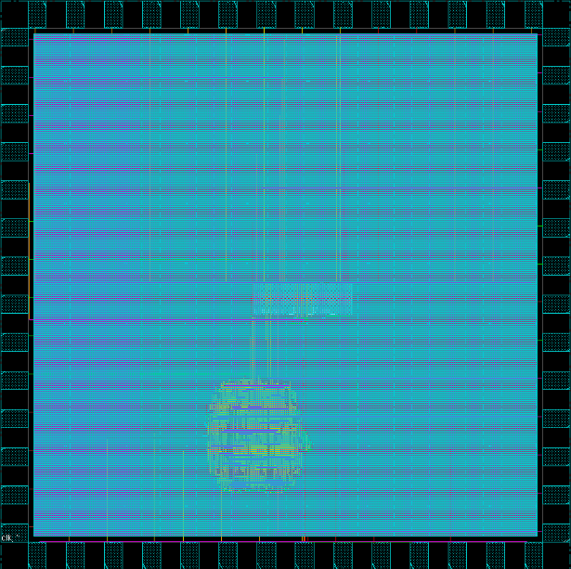
Power planning
Power connections are made using command addStripe to add power stripes on high metal layers
GND
VDD
GND
VDD

Slide 33
Power planning
The cross section through metal layers
Metal 8
Power grid
Metal 7
Metal 6
Metal 5
Routing layers
Metal 4
Metal 3
Metal 2
Bottom layers
Metal 1
Standard cell

Slide 34
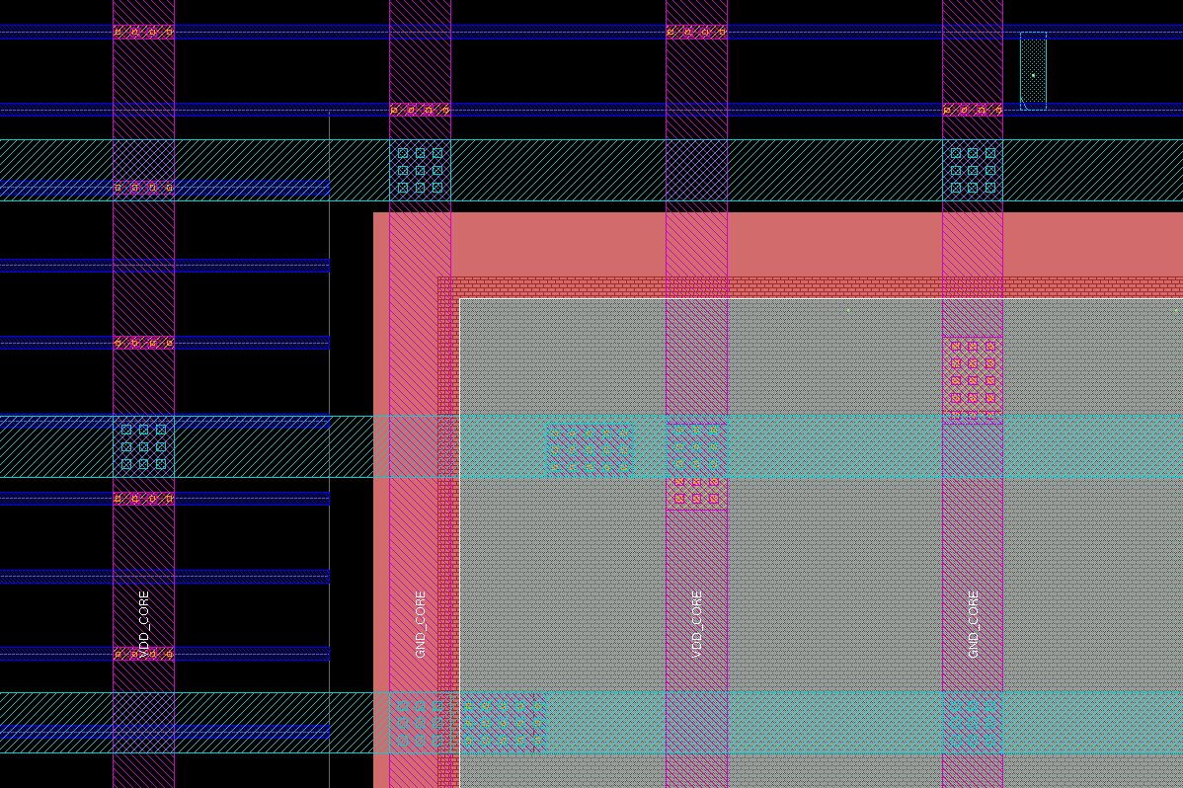
Power planning
Use the command editPowerVia to add VIA down to the power pins of the standard rows and macros. Consult the technology files (like lef) to find out on which layer the power pins are available
PIN GND
DIRECTION INOUT ;
USE GROUND ;
SHAPE RING ;
PORT
LAYER ME3 ;
RECT 0.000 101.520 321.350 103.520 ;
RECT 0.000 1.000 321.350 3.000 ;
RECT 319.350 1.000 321.350 103.520 ;
RECT 0.000 1.000 2.000 103.520 ;
END
END GND
SRAM LEF

Slide 35
Power planning
The cross section through metal layers
Metal 8
Power grid
Metal 7
Metal 6
Metal 5
Routing layers
Metal 4
Vias stack
Metal 3
Metal 2
Bottom layers
Metal 1
Standard cell

Slide 36
Special cell placement
Special cells like hard macros are placed using command placeInstance and by specifying coordinates.
Code example
placeInstance <instance_name> <location> <orientation>

Slide 37
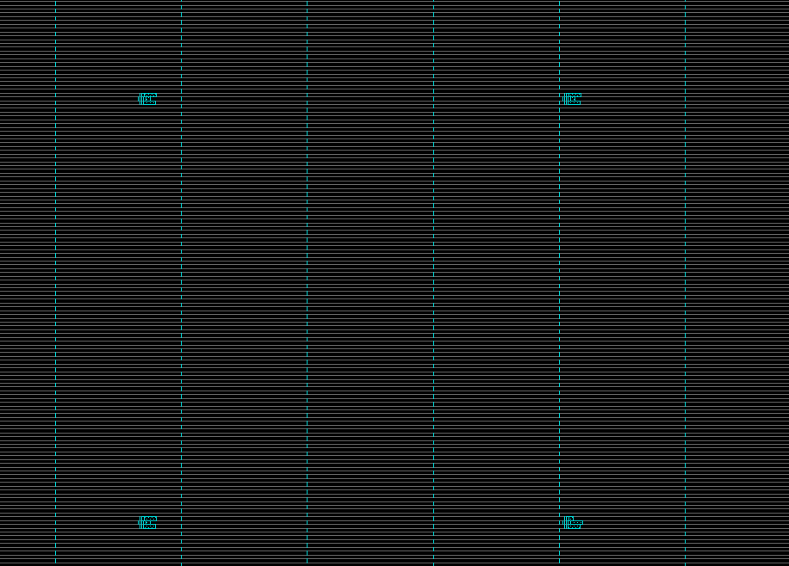
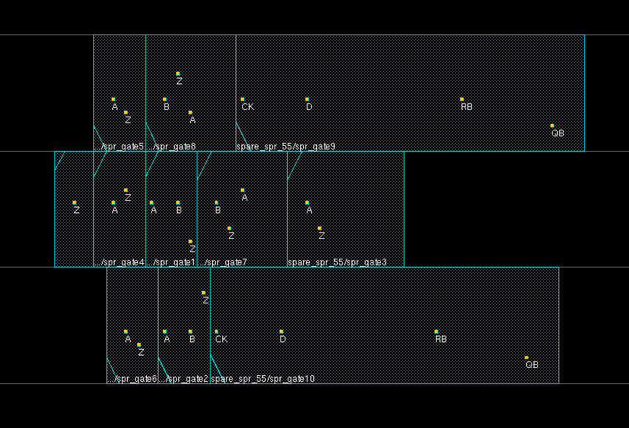
Placement of spare cells
Some clusters of cells can be added on the core area for latter fixes

Slide 38
Standard cell placement
Standard cell placement is quite trivial, the tool automatically place the cells where can be. The command is placeDesign. First routing is done to give a good idea of the feasibility of the design. The tool tries to optimize timing. This preliminary routing is then deleted. After placing the design is optimized using command optDesign –preCTS

Slide 39
Where are we?
Floor planning is done
Input-outputs are set
Power structures have been planned
Standard cells are placed
What remains?
Distribute the clock
Route the design
Respect design rules for manufacturing
Keep timing within acceptable margins
Export the design data for DRC/LVS and production

Slide 40

Setup and Hold
Setup time is the time available until the next clock edge, the input signal of a flip flop should change during this time.
Hold time is the time that is “not available” after a clock edge, the input signal of a flip flop should stay unchanged during this time.
There are several fixes for the violations, some of them can be done in design some of them are done by the P&R tool. For instance, the tool can add skew and start the next flip flop (the flip flop that receives signal) later by adding clock buffers to avoid setup violations.
Concerning hold violations, the tool can start the previous flip flop (the flip flop that generates signal) later or add delay buffers into the data path. This eliminates hold violations.

Slide 41
Multi-Mode Multi-Corner
The timing of the cells depends on conditions such as supply voltage, temperature and on process variations. Different conditions are called corners. There is different library set for every corner. It can be fast, typical and slow corner for process variations. Each delay corner combines liberty (.lib) for the standard cells and the QRC tech files for the nets.
The chip may also have different functional modes (e.g. the “functional mode” with fast clock and the “test mode” with slow clock), that are described by sdc files for each mode.
It is possible to combine corners with modes in the P&R code, such combinations are called views. Further it is possible to tell the tool to use one specific view for the hold time analysis and another for the setup time analysis.
Modes
*
Corners
Test, Functional, Power save etc…
Best, Worst etc…
views

Slide 42
optDesign
In Cadence tools, the optDesign command is used to optimize timing after each phase: before clock tree synthesis, before routing, after routing.
Timing fixes are done for setup and hold separately, fixes may alter manufacturing rules (DRC), DRC may alter timing: always re-optimise the design along the implementation flow.

Slide 43
Clock tree synthesis
Clock is a special net, it has one clock source and many “sinks” – the clock receiving flip flops. Clock is in the design (in the Verilog code) just a net, however on chip it has usually a tree-like structure made of clock buffers. Clock tree is mandatory for synchronous design: one buffer cannot drive every flip flop. The clock should arrive almost at the same time at each flip flop. The aim of the clock tree synthesis is to produce the clock tree and assure that there are no setup and hold violations.
Sinks
clk
root

Slide 44
Clock tree synthesis
Clock skew is the difference between the clock edges at two flip flops, one of them is generating the signal (the launch flip flop) and the other receiving it (the capture flip flop). Clock skew is defined as Skew = Tcapture – Tlaunch. It can be positive and negative. Positive skew leaves time for setup. Negative skew removes time for setup and it is good for hold. The original task of clock tree synthesis is to minimize the clock skew.
Launch
Capture
Tlaunch
Tcapture
Skew = Tcapture - Tlaunch
Positive: Leaves time for setup
Negative: Removes time for setup

Slide 45
Clock latency
Clock latency is used to describe the time clock signal needs to reach the flip flops. It is measured from the clock source to the flip flop input.
clk
Local Skew
Global Skew
Latency

Slide 46
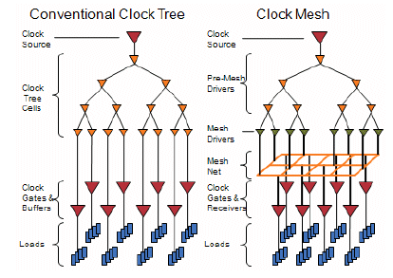
Tree vs. mesh
There are two types of clock routing.
Standard clock tree is commonly used.
Clock mesh uses a grid structure to reduce the skew.
Clock mesh seems to be a better solution when there is a significant on chip variation of standard cell delays.
http://www.design-reuse.com/articles/21019/clock-mesh-benefits-analysis.html

Slide 47
Usefull skew
An advanced option of clock tree synthesis is to use positive/negative skew to improve setup or hold timing. This feature should be used with precaution.
Launch
Capture
Tlaunch
Tcapture
Inserted delay

Slide 48
Input and output timing
Clock tree latency influences the capturing of input signals and generation of output signals. It can cause the input to register and register to output time violations. These violations are not serious as the setup and hold violations on chip because the external circuits can be modified to cope with too late outputs or they can generate the signals for the chip earlier or later.
Output delay constraint
Latency
Remaining time
out
clk

Slide 49
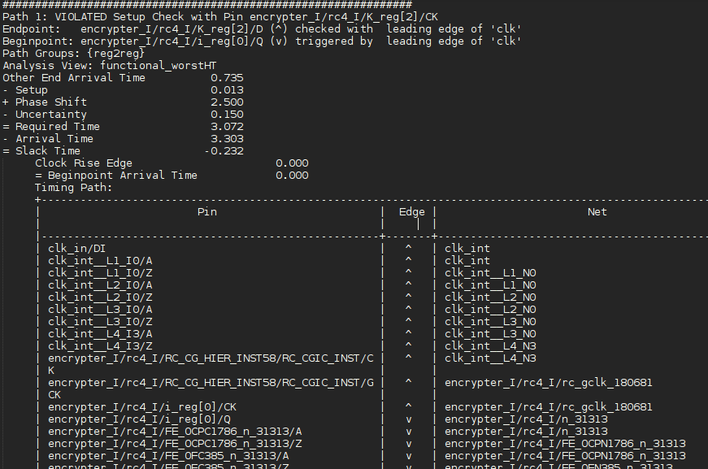
Timing report
clk

Slide 50
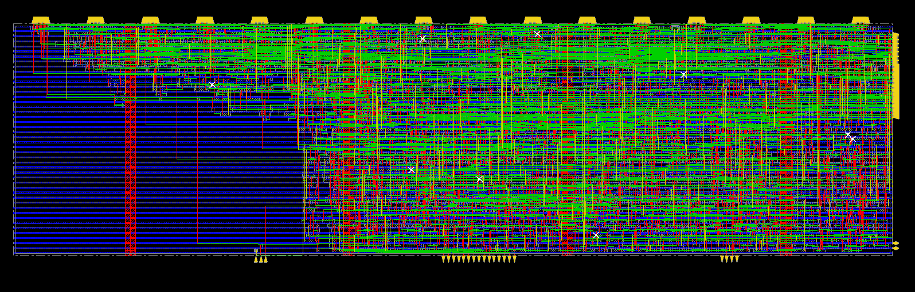
Routing
During routing process following is done:
Data paths are routed with accurate calculation (extraction) of line capacitances and resistances. During routing crosstalk and signal integrity are taken into account. Design rules are followed. Contacts between metal layers (the vias) are optimized by using double cuts. Antenna violations are fixed. The routing procedure can optimize the timing (timing driven routing) or try to avoid signal errors due to capacitive crosstalk (signal integrity driven routing).

Slide 51
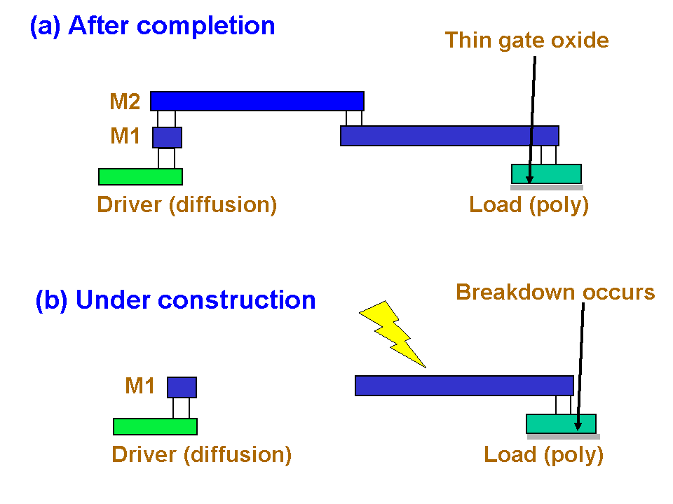
Antenna effect
Antenna effect is a risk during manufacturing process. During production of routed lines, especially ion etching or polishing, charge is generated which increases the voltage of the lines. The high voltage can damage the transistor gates that are connected to the lines. IC would not be working if it happens. The problem can be fixed by adding electrostatic discharge protection diodes (antenna cells) or by making the metal bridges. A command verifyProcessAntenna will perform antenna violation fixing

Slide 52
Antenna effect
Metal 2
Metal 1
Poly
Bridge Fix
Metal 2 Build after Metal 1
Metal 2 is Short
Antenna FIX

Slide 53
Signoff
Some final steps should be done before manufacturing
Unused area is filled with filler cells with command addFiller. The cell names must be written in the code, they are found in technology documentation
Verify and fix DRC
Recalculate timing and fix setup and hold violations
Perform metal filling to fix density rules
Write out the GDS file
Perform layout versus schematic checks

